Slide 1

Human Resource Management(HRM)
Working Backwards, And Other Insights, Stories, and Secrets from Inside Amazon —

Slide 2
Agenda
Introduction
HRM
HR policies at Amazon
Company principle
Company culture
HR Selection
Training and development at Amazon

Slide 3
Introduction
Founded in 1995, Seattle, Jeff Bezos.
The name "Amazon"
E-commerce and cloud-computing
Started as "online bookstore"
Now the largest online retailer of the U.S.

Slide 4
HRM
The strategic approach to the effective management of organization workers so that that they help the business gain a competitive advantage.
Designed to maximize the employee performance to services of an employee's strategic objective.
Primarily concerned with the management of people within organization, focus on policies and systems.
Responsible for overseeing employee benefits designing, employee recruitment, training &development, reward.

Slide 5
HR policies at Amazon
PROS
Driven by the pioneering spirit that is part of the company's DNA.
Continuous learning environment.
Really smart people
A lot of opportunity of growth
Always encouraged to be innovative and think big & create something new.
Competitive salary and benefits.
100% self-motivating work environment.
No dress code.
4 legged friends are welcomed.

Slide 6
HR policies at Amazon
Cons
Workers are expected to embrace "frugality", from the bare-bones desks to the cellphones and travel expenses that they often pay themselves. (No daily free food buffet or regular snack supplier).
You have to be self-motivated.
No work life balance.

Slide 7
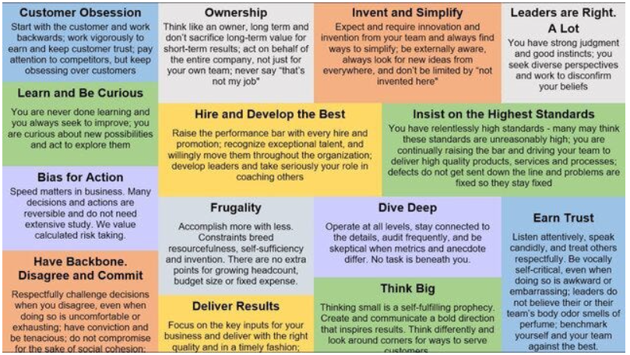
Company principle

Slide 8
Company culture
Customer obsession instead of competitor obsession.
A willingness to think long-term.
An imperative to invest and accept the frequent failures that arise from this objective.
Professional pride in operational excellence.

Slide 9
Hire selection
Develop the job description.
Review the resumes.
Do a phone screen.
In-house interview loop.
Written feedback.
Debrief/Hiring meeting.
Reference check
Offer through onboarding.

Slide 10
Training & development at Amazon
Provide a good form of training program for their employees.
Provide time to time training and development schemes for the old and the new employee also there are two type of orientation program: PHO & NHO.
Employee hiring are two basis: contractual basis and permanent basis.
Very strict about the employee login hour bass and woman safety is the first priority of Amazon

Slide 11
Thank you

